Slide 1
LECTURE: 6
PROBLEM SPACES AND SEARCH

Slide 2
Defining Problem as State Space Search:
Initial State: Problem's starting point.
Goal State: Desired final condition.
State Space: All possible configurations explored.
Operators: Actions transition between states.
Objective: Find solution through systematic exploration.
Path: Sequence leading to goal state.

Slide 3
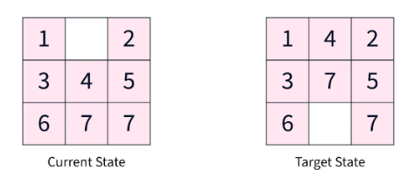
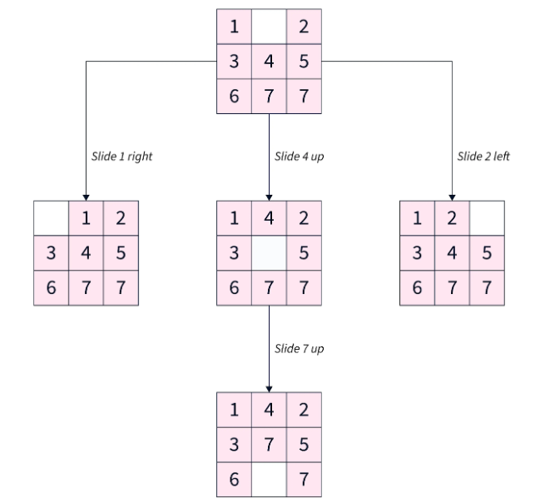
Example- Puzzle solving:

Slide 4
Principles/Features of State Space Search:
Expansiveness: Number of successors per state.
Branching Factor: Average successors per state.
Depth: Length from initial to goal.
Completeness: Guarantees solution if it exists.
Time Complexity: Duration of the search process.
Space Complexity: Memory needed during search.

Slide 5
Steps in State Space Search:
Step 1: Define the state space.
Step 2: Pick a search strategy.
Step 3: Start the search process.
Step 4: Extend the nodes iteratively.
Step 5: Prevent state repetition.
Step 6: End the search when found.

Slide 6
Heuristics in State Space Search:
Heuristics: Techniques to guide search efficiently.
Admissible Heuristic: Never overestimates goal cost.
Informed Search: Searches blindly without heuristics.
Uninformed Search: Searches without heuristic guidance.
Heuristic Function: Estimates the cost to goal.

Slide 7
State Space Representation:
States: Problem arrangements, represented as nodes.
Initial State: Starting point of the search.
Goal State(s): Desired problem-solving configuration(s).
Actions: Processes for transitioning between states.
Transition Model: Defines action-state outcomes.
Path Cost: Numerical cost for state transitions.

Slide 8

Next: Decoding Problems with Production Systems!

